Slide 1

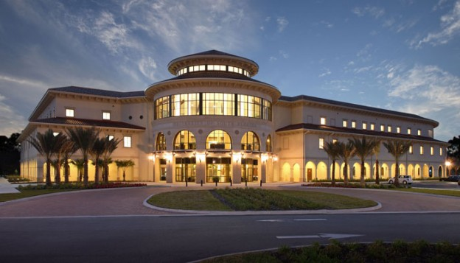
Week- 7 Writing User Stories As Part of Capturing Requirements Dr. Bhuvan UNHELKAR IT Faculty, College Of Business; Office: C225; bunhelkar@sar.usf.edu; 941-359-4654

Slide 2

Agenda
Capturing the Requirements
In an Agile Project
Writing good User Stories
What are User Stories?
Different TYPES of User Stories
The format for Writing User Stories
Challenges & Insufficiencies of User Stories
Summary & Consolidation

Slide 3

Sub-Module User Stories
A key Artifact
© MethodScience; Material Designed and Presented by Dr. B. Unhelkar; drawn from The Art of Agile Practice

Slide 4
A User Story
Role
As a Customer
(The Actor or Key beneficiary)
Process
I want to Identify myself
(The Steps taken)
Goal (Benefit)
So that I can Withdraw Cash
(Purpose of the Use case)

Slide 5
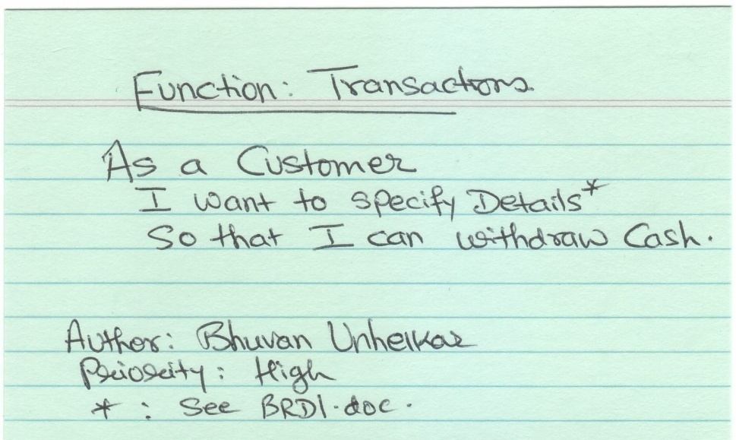
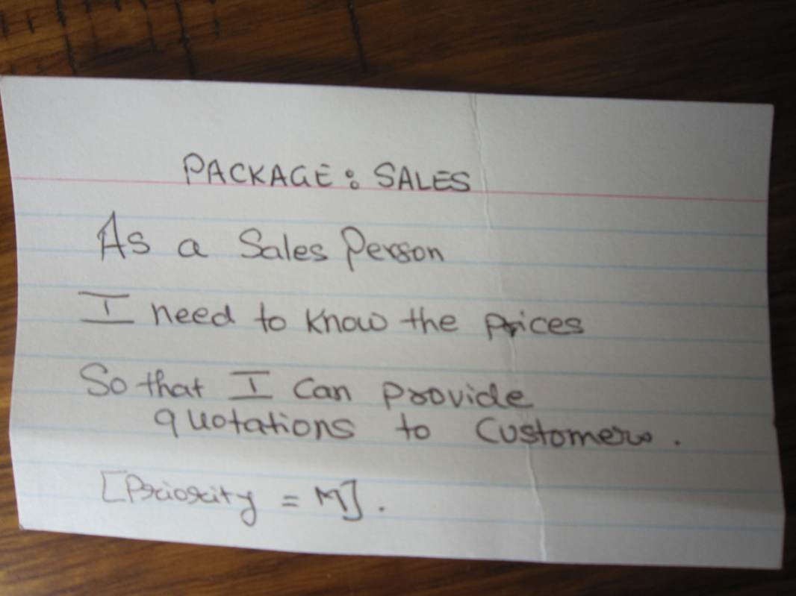
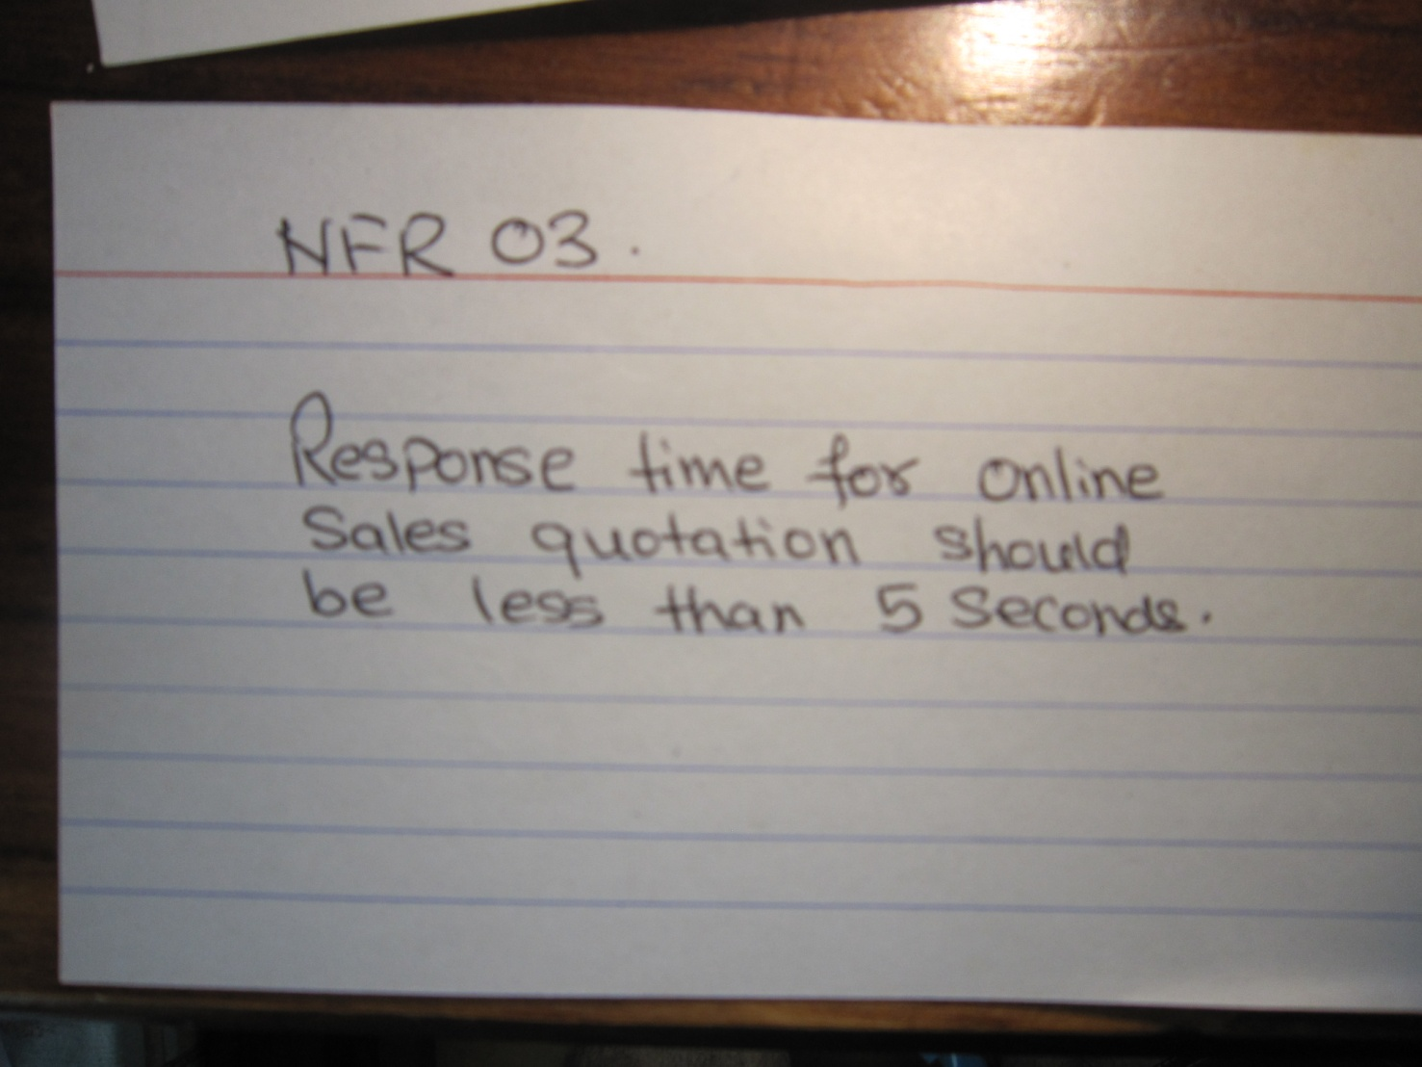
Figure 5.14: User Story (Unit of Functionality and a Non-Functional Feature)
A
B
C
Notes:
Use stories can replace use cases – but not quite. This approach to modeling requirements is more suited to Agile development approaches.
Worth trying due to its simplicity – but the challenge is its scalability.
Conversations with Users (stake holders)
Format (based on Mike Cohn’s User Stories Applied): As a (role) I want (something) so that (benefit).
Suggestion: Add Test case at the Back

Slide 6
Figure 5.9: Types of Non-Functional Requirements in an Organization/System/Project [Background – Architectural Modeling Space] They form basis for Features/NFR on the Wall
Performance (Bandwidth)
Scalability (Time)
Security (Levels)
Volume (Databases)
Reliability (Trust, Risk)
Operability (Platforms)
Environment (Carbon)
Availability, Maintainability (QoS)
Legal (Compliance)
© www.methodscience.com
Notes:
Many more requirements that CANNOT be documented functionally are discovered in real projects. All are important for the success of the project, but may not be easily documented in UML (at least the current version).
FROM www.requirements.com;
There are a significant number and this is not an exhaustive list of categorises:
Accessibility Requirements , Accuracy Requirements
Auditing and Reporting Requirements, Availability Requirements
Backup and Recovery Requirements, Capacity Requirements
Compatibility Requirements, Concurrency Requirements
Configurability Requirements, Error-Handling Requirements
Legal and Regulatory Requirements, Licensing Requirements
Localizability Requirements, Maintainability Requirements
Performance Requirements, Precision Requirements
Redundancy Requirements, Reliability Requirements
Scalability Requirements, Security Requirements, Stress Requirements
Supportability Requirements, Throughput Requirements
Note that non-functional requirements tend to be the 'ilities" of the system aka availability, accessibility, etc

Slide 7
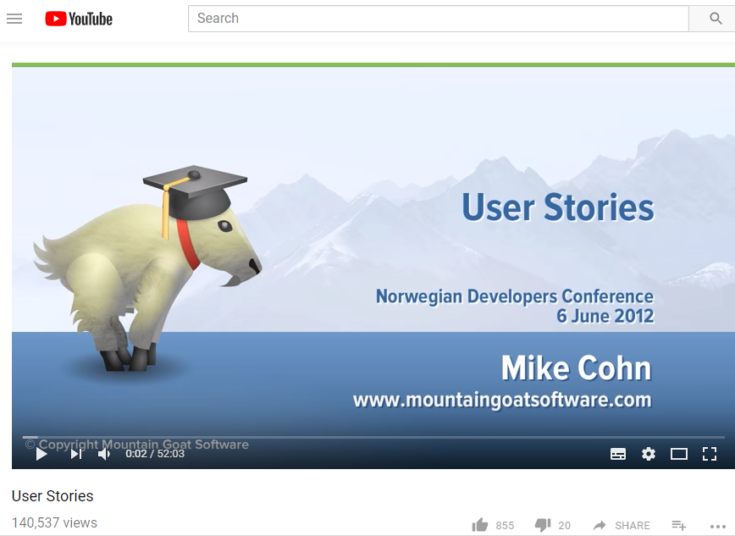
Mike Cohn on User Stories: https://www.youtube.com/watch?v=6q5-cVeNjCE
Card
Conversation
Confirmation

Slide 8
Sub-Module Wall - The Agile Wall
Based on the Kanban board:
A visual Collaboration and Tracking technique
© MethodScience; Material Designed and Presented by Dr. B. Unhelkar; drawn from The Art of Agile Practice

Slide 9
Kanban Board
Kanban in Japanese means "visual signal" or "card.“
Kanban forms the philosophical basis for the “Wall” of Agile
Kanban enables easy, current and visual communication of an initiative (Project)
Toyota used these technique in JIT (Just in Time) inventory to reduce waste and maximize value.

Slide 10
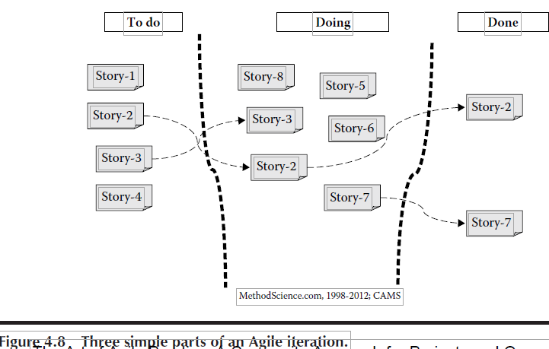
Figure 4.8: An Agile “Wall”

Slide 11
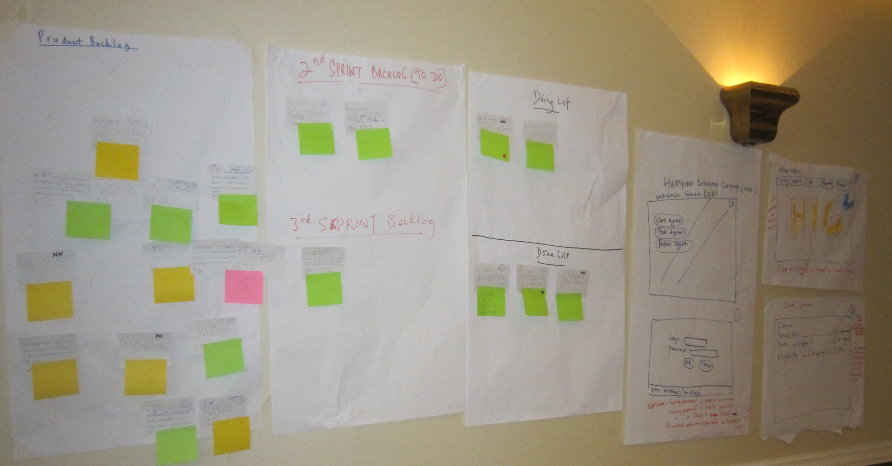
Figure 5.15: Visible Charts depicting Product/ Sprint backlogs in Implementation Process-Map in Practice
Requirements
Analysis / Design
Code / Test
Showcase / Accept

Slide 15
Sub-Module W
A
© MethodScience; Material Designed and Presented by Dr. B. Unhelkar; drawn from The Art of Agile Practice

Slide 19
Sub-Module W
A
© MethodScience; Material Designed and Presented by Dr. B. Unhelkar; drawn from The Art of Agile Practice

Slide 23
Sub-Module W
A
© MethodScience; Material Designed and Presented by Dr. B. Unhelkar; drawn from The Art of Agile Practice

Slide 27
Sub-Module W
A
© MethodScience; Material Designed and Presented by Dr. B. Unhelkar; drawn from The Art of Agile Practice

Slide 31
Sub-Module Agile Job Aids
And a Discussion Question
© MethodScience; Material Designed and Presented by Dr. B. Unhelkar

Slide 32


Slide 33
Sub-Module Agile Teams
Cross-Functional; Co-Located;
© MethodScience; Material drawn from The Art of Agile Practice (B. Unhelkar)

Slide 34
Conclusions & Future Directions
We discussed…??
Do you see what we see?

